Slide 1


Git Ethics exercise
Hugh Shanahan
July 2022 CODATA-RDA Data Science School

Slide 2
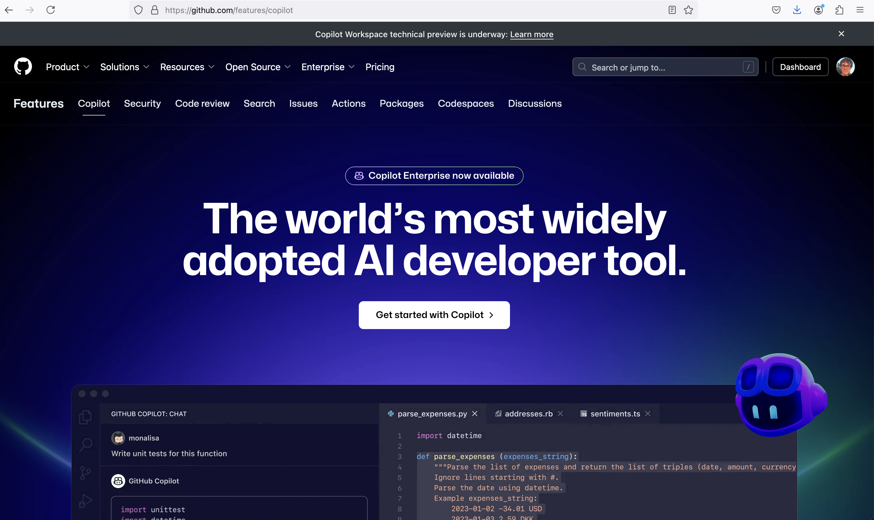
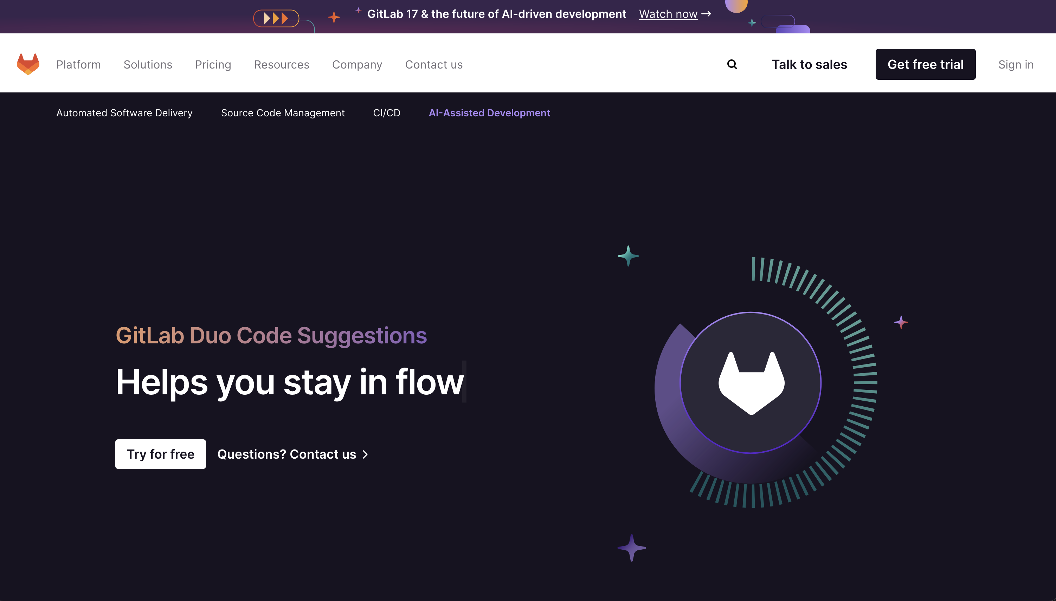
Remote repos and LLMs
GitHub (and Gitlab) offer a copilot service

Slide 3
Explainer
In effect – “ChatGPT for developing software”.
Insert some software you’ve written into one prompt.
Put down request to do something in another field.
Copilot will generate additional software.
Not a replacement for software engineers but definitely improves productivity (perhaps ~20%)

Slide 4
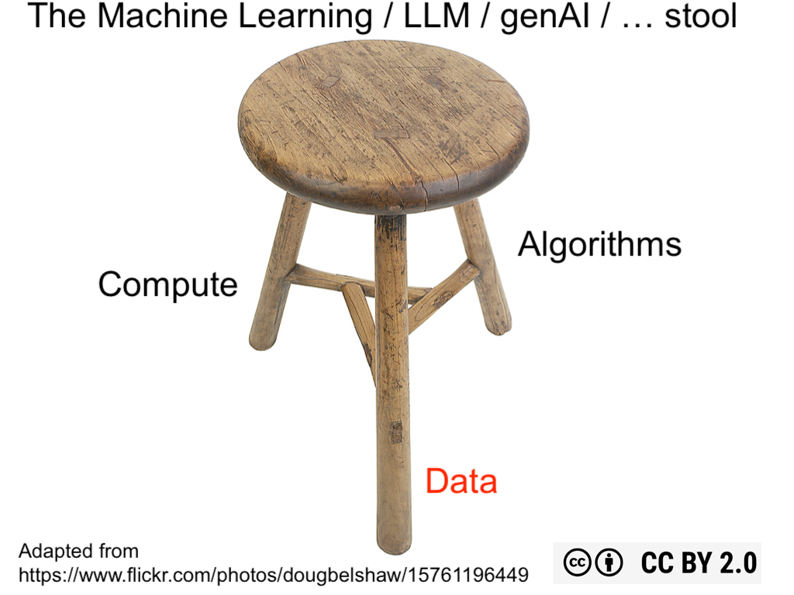
LLMs in a nutshell

Slide 5
What is (probably) happening
GitHub and GitLab are using their vast arrays of repos to train their LLMs.
Companies keep quiet about precisely what data they use.
Your depositions are being used to train their LLMs.

Slide 6
LLMs are expensive!
You have to pay to access copilots.
E.g. (Aug 2024) Github charges $10 per month for a single user.
Github goes to great detail explaining that what you put into a prompt is not used to train their models.
…but they don’t mention repos you just upload.

Slide 7
Exercise
On one green post-it give one reason why there is an advantage to this current situation.
On one red post-it give one reason what you see as a disadvantage of this.
On another post-it list one change you would like to see in the future to make things work better.

